Slide 1

ULang
Chris Jantzen, Chris Messmer, Robert Bolgzds
Advisor: Chia Han

Slide 2
Abstract
ULang is a foreign language learning application focused on note keeping and practicing languages as you learn. It will feature verb conjugation tables to study all of the forms and tenses of verbs, customizable vocabulary sets, as well as a section that will speak words or sentences of the language to the user and listen to the user speak it back to check for correct inflection and vocabulary, and more. ULang will be a cloud-based web application, and will leverage natural language processing APIs and toolkits to create an interactive language learning experience.

Slide 3
User Stories
As an English speaker, I want to practice Spanish vocabulary so I can become more fluent in Spanish.
As an English speaker, I want to practice French verb conjugations so I can become more fluent in French.
As an English speaker, I want a note taking tool to help learn German.
As an English speaker, I want to practice Spanish pronunciations so I can learn how to properly speak Spanish.

Slide 4
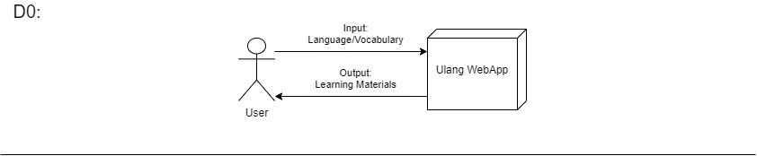
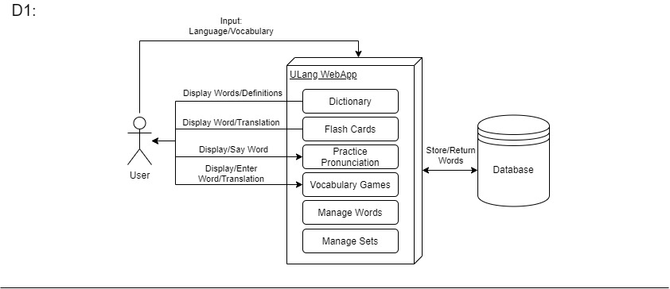
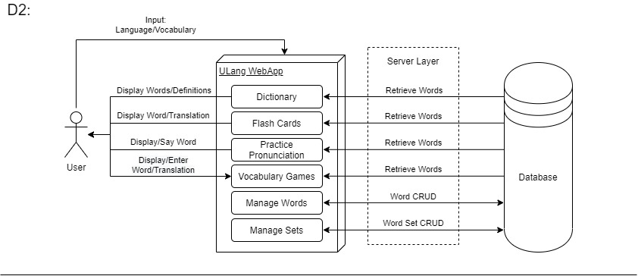

Slide 5
Constraints
Economic Cost
Cloud hosting, domain name, potential API use
Time
Semester constraint, competing with other responsibilities
Technical Experience
Elegant database design, knowledge of foreign languages’ rules, natural language processing, UI design
Ethical & Legal
Data privacy
Voice audio, email/passwords, account info
Transparency
Where data is sent e.g. Google APIs, how data is stored and used

Slide 6
Constraints cont.
Security
Secure data storage, secure audio data, secure communications
Social
Intended for public use, high usability standards
Diversity & Culture
English as base language
Only support Latin/Germanic languages

Slide 7
Current State
Expected Accomplishments
Wrapping up Planning phase.
Beginning research and development
Complete research
Initial development

Slide 8
Division of Work
Database - Jantzen
Cloud Platform - Bolgzds
Natural Language Processing - Messmer
UI/UX - Messmer
User Dictionaries - Jantzen
Flash Cards - Messmer
Pronunciation Practice - Bolgzds
Testing, Revision, Documentation - Jantzen, Messmer, Bolgzds

Slide 9
Expected Demo
Functional Web App
Ideally we will have a fully functional webapp to be demoed at the expo.
Create Account
Input Language & vocab
Access learning materials

